Slide 1
Employee Association Management System
WELCOME

Slide 2
Title of the Project : Employee Association Management System
Author’s Name : Mohd Bilal Jagir Hussain Shaikh
Class : Bachelor of Science in Information technology
College : SIES College
Reg No. : +91 9137121198

Slide 3
Introduction :
Developed for the Employees Association
Saves management’s lot of time
Stores Bank’s employee records
Provides training materials
Latest news and announcements
Employees discussion forum
CATEGORY :
Relational Database Management System (RDBMS)
Client :
Syndicate Bank Employees Association

Slide 4
OBJECTIVES
Association provides
Training material : documents, videos, pdf files etc
Discussion Forum : queries, replies from management and employees
News : latest news, events and announcements
Mail : employees can communicate with others by mail
SMS and Email notification : sms and email notification after new employee registration

Slide 5
SCOPE OF THE SYSTEM
Employees get immediate response to their queries
Saves the management’s lot of time
Avoids communication gap between the Syndicate Bank employees and the management
Web application is user friendly

Slide 6
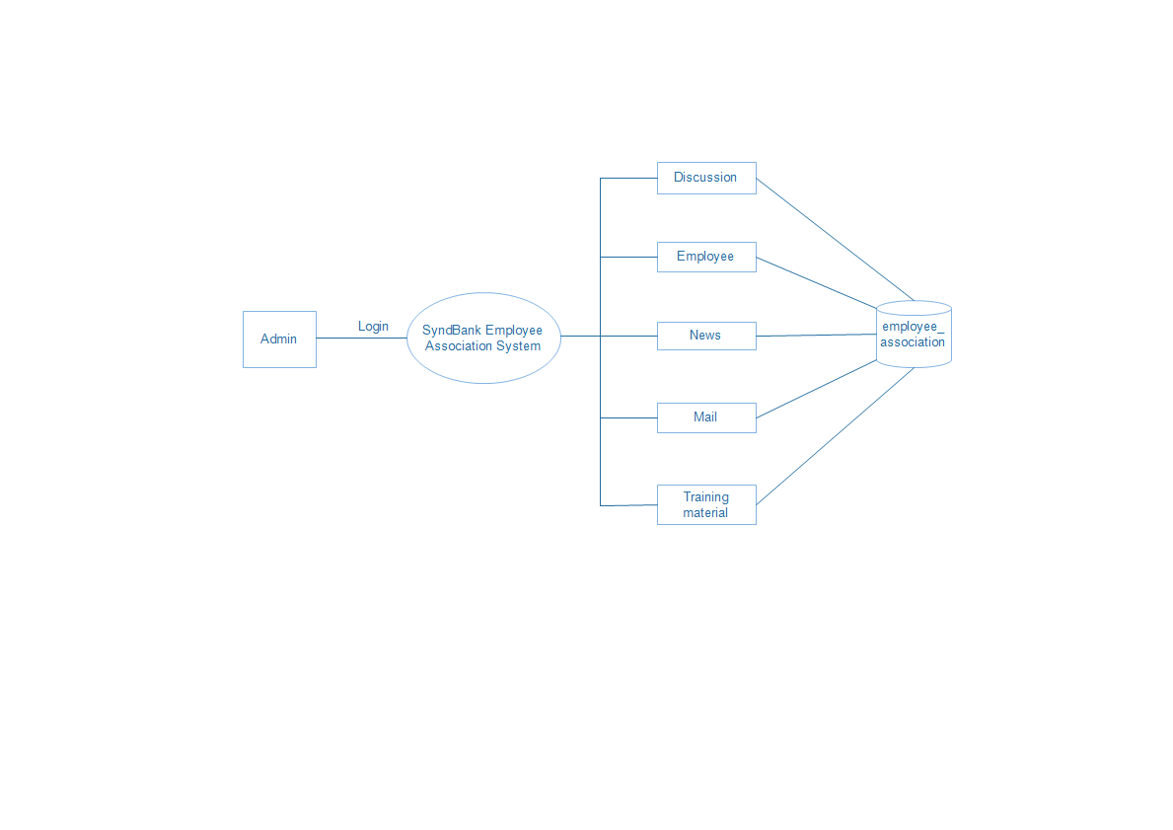
STRUCTURE OF THE SYSTEM

Slide 7
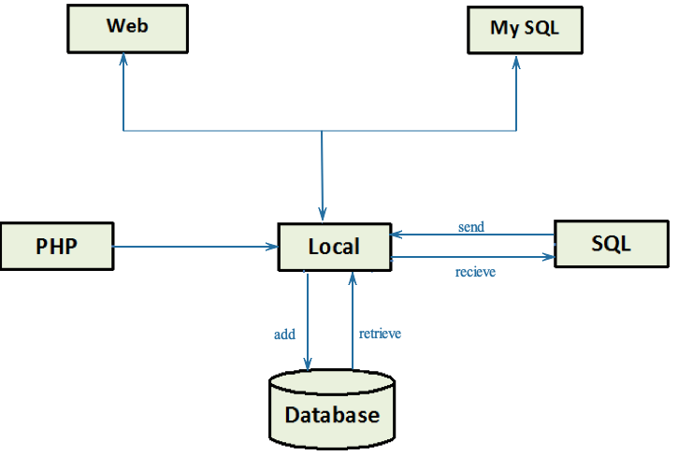
SYSTEM ARCHITECTURE

Slide 8
HARDWARE AND SOFTWARE REQUIREMENTS
Processor | Pentium Dual Xenon Processor
RAM | Minimum 512 MB
Hard Disk | Minimum 4. GB
Operating System | Windows XP / Windows 7 / Windows 8
Software | XAMPP Software v 3.2.1
Server | Apache Server 1.8.2
Database Server | MySQL database Server 5.5
IDE | Adobe Dreamweaver CS 6.0

Slide 9
USER CHARACTERISTICS
Administrator :
Has full authority.
The username and password for the employee is given by the administrator.
Communicate with employees via discussion forum or mail
Publish training materials, news and events
Employee :
Post and reply queries in discussion forum
Allowed to access the services given by the administrator like viewing mails, latest news and events.

Slide 10
SOFTWARE ARCHITECTURE

Slide 11
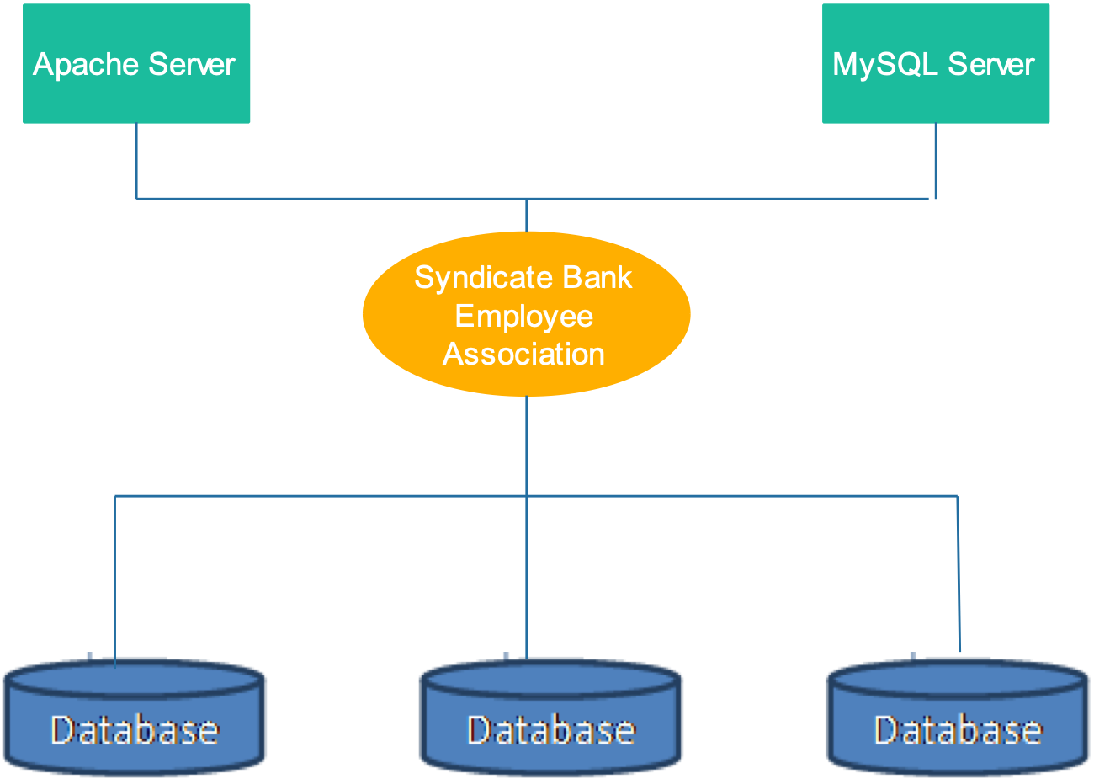
TECHNICAL ARCHITECTURE

Slide 12
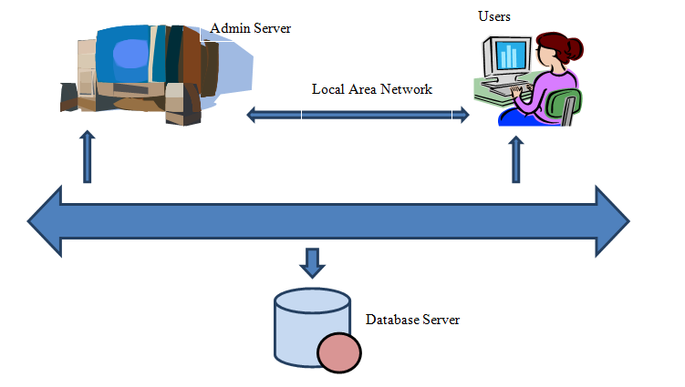
HARDWARE ARCHITECTURE

Slide 13
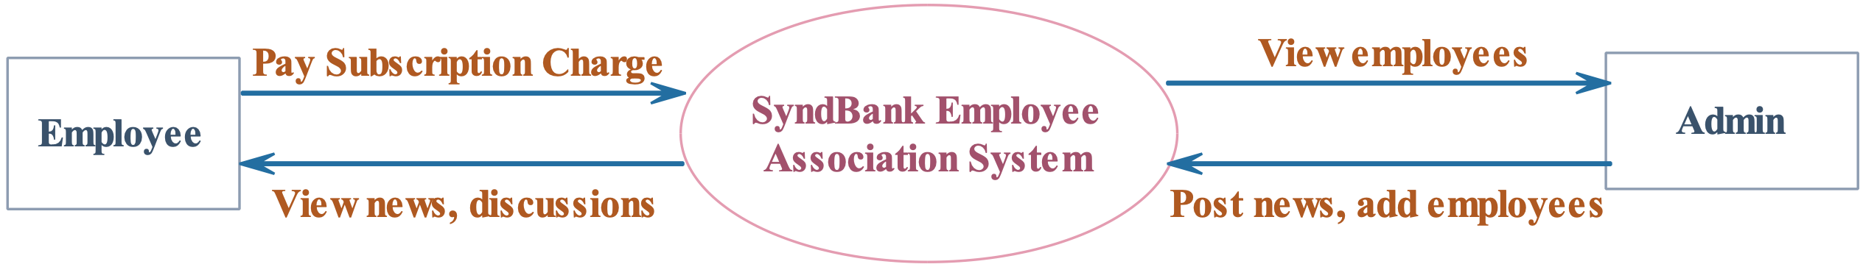
CONTEXT FLOW DIAGRAM

Slide 14
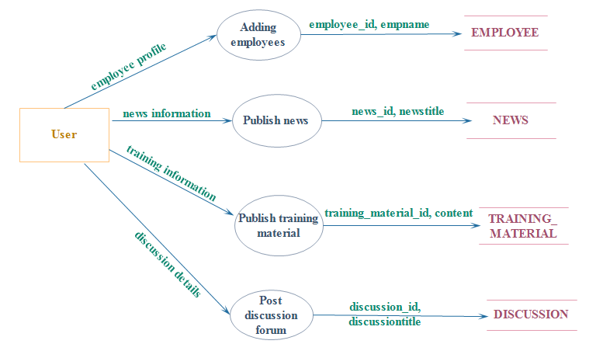
Top level dfd

Slide 15
Description of Components
1. Employee registration process
Input: Adding branch, designation and employee details
Process: The system checks whether the entered information of the form is valid or not.
Output: If the entered information is valid then the employee will receive an SMS and Email to the registered account.
2. Publish news
Input: Entering the news details like news content, news type, news title, news publish date
Process: The system checks whether the validation of the entered information is correct or not.
Output: If entered data is valid then the system publish the news on the given date.

Slide 16
3. Upload training material
Input: Uploading the training material details like Employee Name, Title, Training Category, Image Link, Video Link, Content and Status
Process: The system checks whether the validation of the entered information is correct or not.
Output: If entered data is valid then the system uploads the training materials to the server.
4. Post discussion forum
Input: Post discussion details like Employee Name, Category, Discussion Title, Description, Discussion Image, Publish Date, Uploads and Status
Process: The system checks whether the validation of the entered information is correct or not.
Output: If entered data is valid then the system post the discussions.

Slide 17



Schema information
Table name : branch
Table name : designation
Table name : subscription
Table name : employee

Slide 18
Table name : subscription_tariff
Table name : discussion
Table name : discussion_reply
Table name : mail
Table name : news

Slide 19
TABLE DEFINITION
Table Name: employee
Column | Type | Index | Description
employee_id | int(10) | Primary Key | Employee unique ID
branch_id | int(10) | Foreign Key | Branch unique ID
designation_id | int(10) | Foreign Key | Designation unique ID
empname | varchar(25) | Not Null | Employee Name
dob | Date | Not Null | Employee date of birth
gender | varchar(10) | Not Null | Employee gender
address | varchar(250) | Not Null | Employee address
country | varchar(25) | Not Null | Employee country
state | varchar(25) | Not Null | Employee state
city | varchar(25) | Not Null | Employee city
pincode | varchar(10) | Not Null | Employee pincode
doj | Date | Not Null | Employee date of joining
dor | Date | Not Null | Employee date of retirement
login_id | varchar(25) | Not Null | Employee login ID
password | varchar(250) | Not Null | Employee password
empimage | varchar(100) | Not Null | Employee image
note | Text | Null | Employee note
status | varchar(10) | Not Null | Employee status

Slide 20
Table Name: training_material
Column | Type | Index | Description
training_material_id | int(10) | Primary Key | Training material unique ID
employee_id | int(10) | Foreign Key | Employee unique ID
Title | varchar(150) | Not Null | Training material title
training_category | varchar(25) | Not Null | Training material category
image_link | varchar(100) | Not Null | Training material image
video_link | varchar(100) | Not Null | Training material video
Content | Text | Not Null | Training material content
Status | varchar(10) | Not Null | Training material status

Slide 21
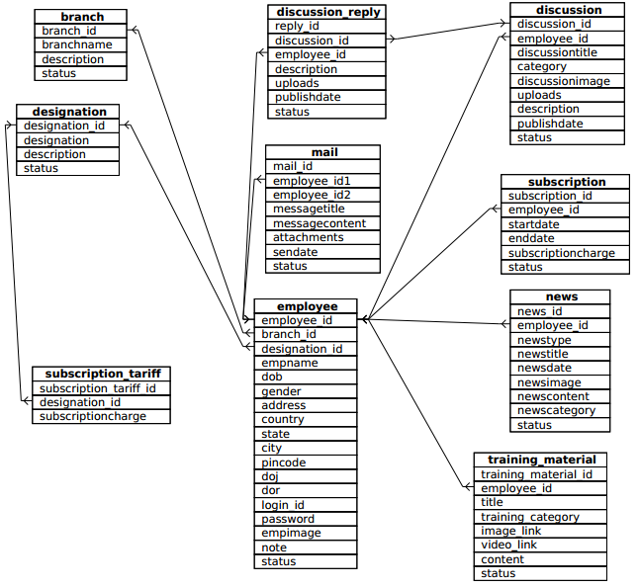
PHYSICAL DESIGN

Slide 22
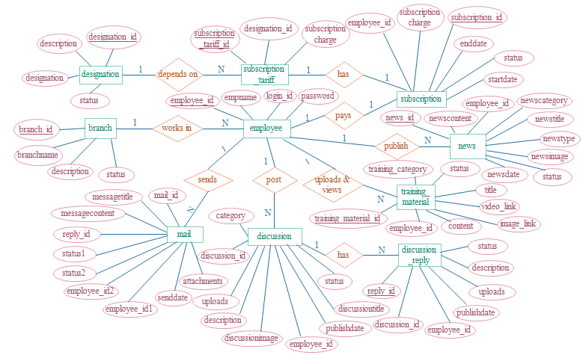
ER DIAGRAM

Slide 23
DATABASE ADMINISTRATION
System Information:
Document the database management system configuration, hardware configuration, database software utility and any support software used.
DBMS Configuration:
Client server architecture allows multiple user access to database through connection to one or more DBMS server process.
Backup and recovery:
If the system crashes all the information of database will get lost and there is no any other special software to recover the lost database. So it is important to keep the backup of the database information in external hard disk or local server.

Slide 24
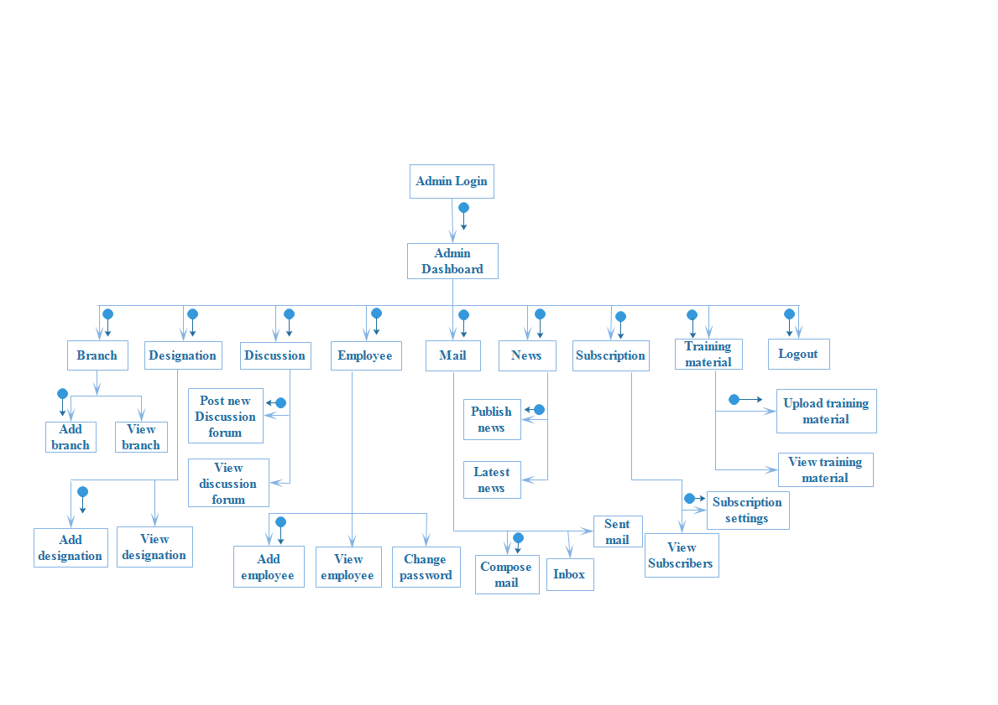
STRUCTURE CHART

Slide 25
MODULES
Employee module – add and view employees details
Branch module – add and view branch details
Discussion module – post and reply for discussion forum.
Designation module – add and view designation details
News module – view latest news and events
Mail module – compose , send and view mails
Training material module – upload and view training materials
Subscription module – annual subscription tariff

Slide 26
CODING
Database connection :
<?php
$con=mysqli_connect("localhost","root","gube","employee_associaion");
if(mysqli_connect_error())
{
echo "Failed to connect to MySQL:".mysqli_connect_error();
}
?>

Slide 27
Authorization :
if(isset($_POST[btnsignin]))
{
$sql= "SELECT * FROM employee WHERE login_id='$_POST[login_id]' AND password='$_POST[password]' AND status= 'Active' " ;
if(!$qrs=mysqli_query($con,$sql))
{
echo mysqli_error($con);
}
}

Slide 28
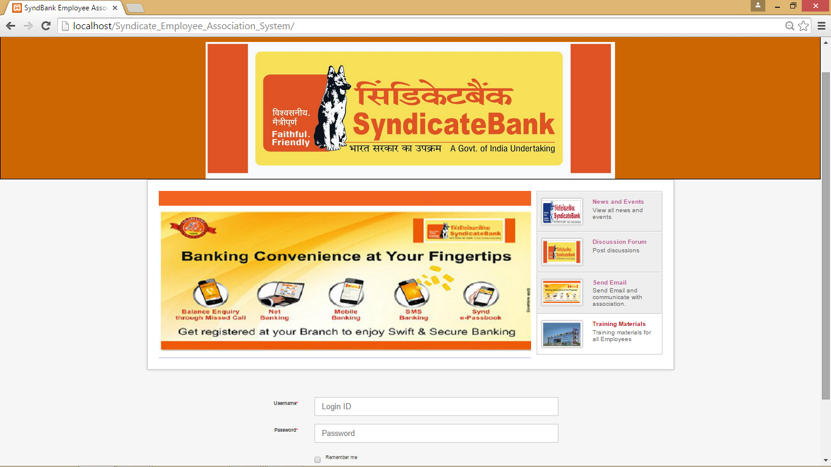
User interfaces
Login :

Slide 29
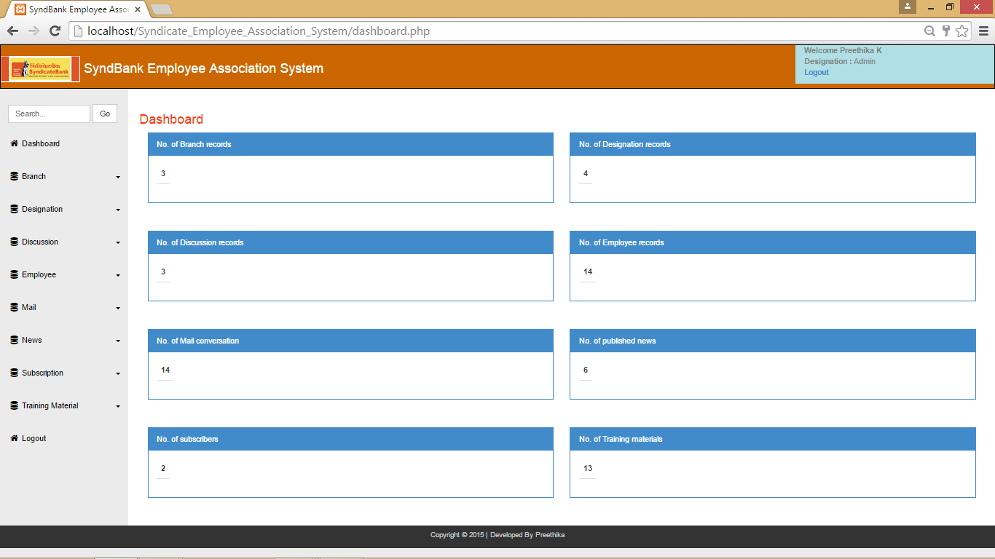
Home Screen

Slide 30
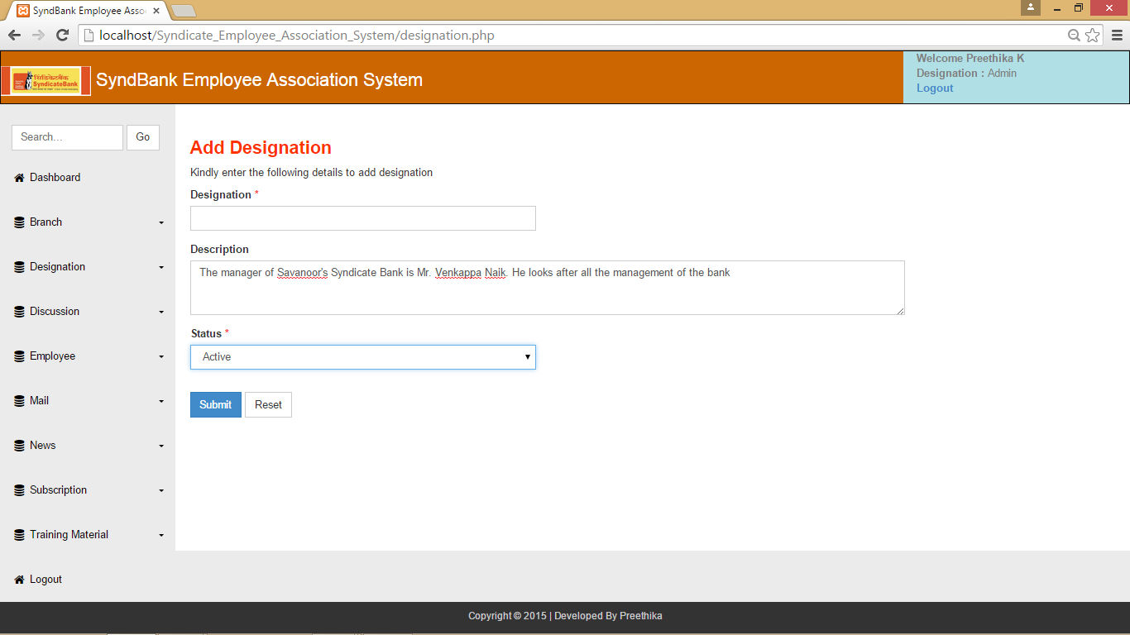
Validation :

Slide 31
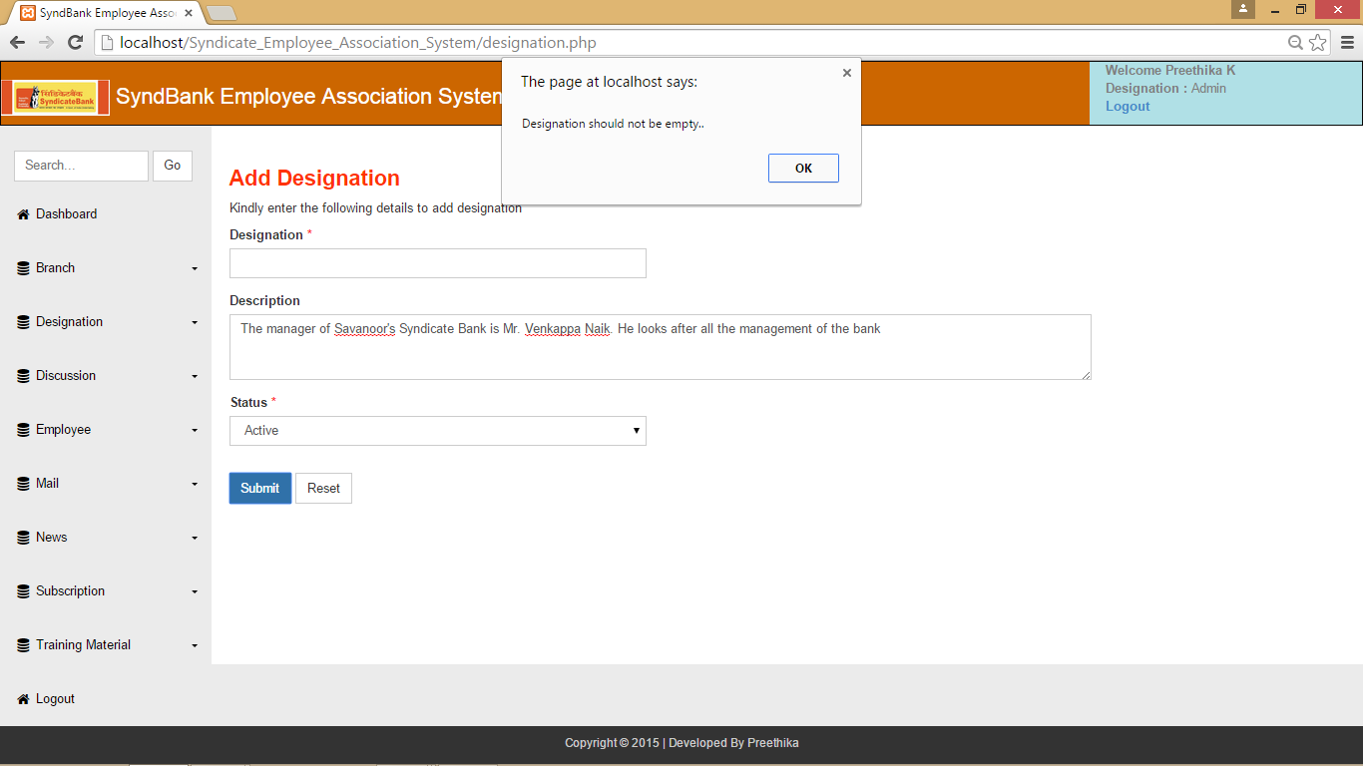

Slide 32
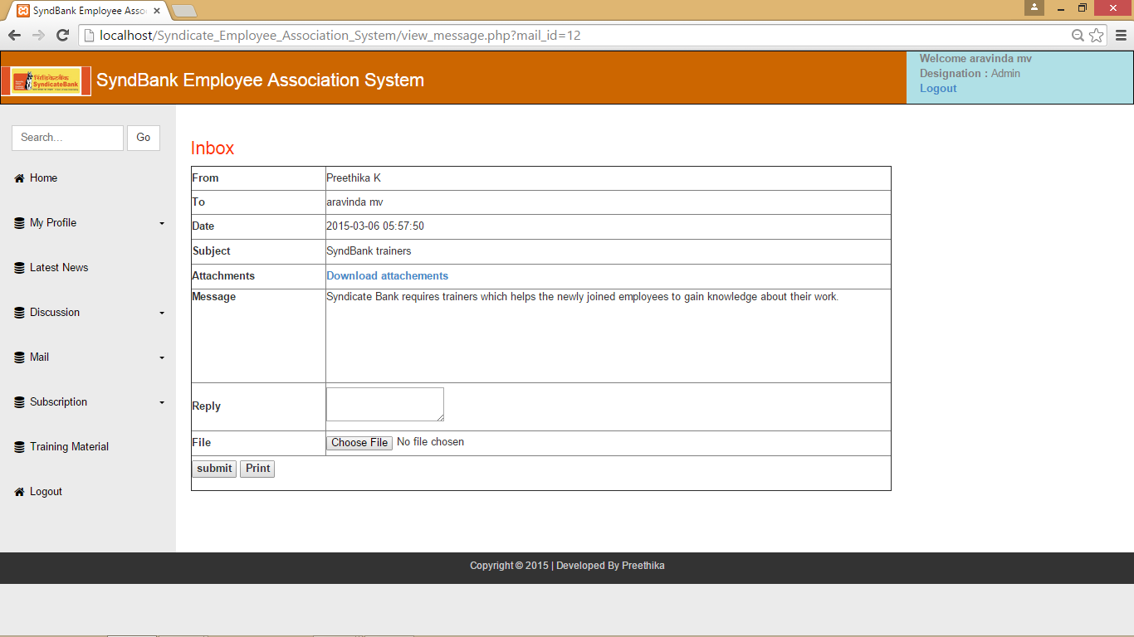
Data Report :

Slide 33
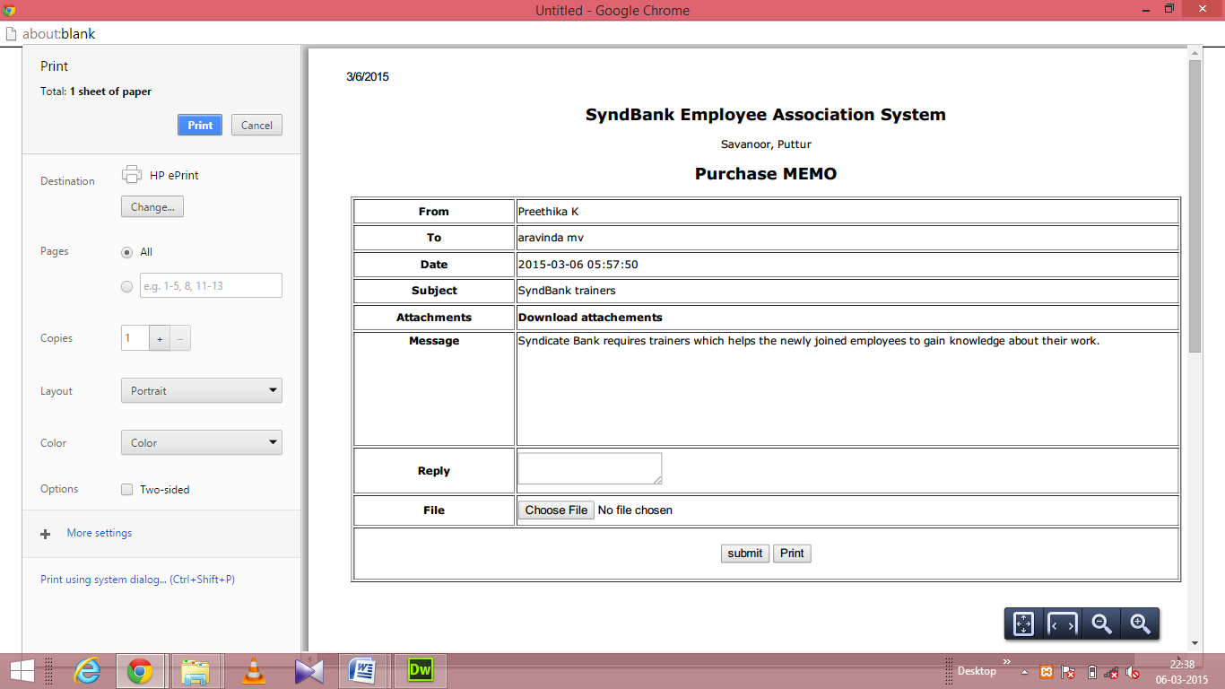

Slide 34
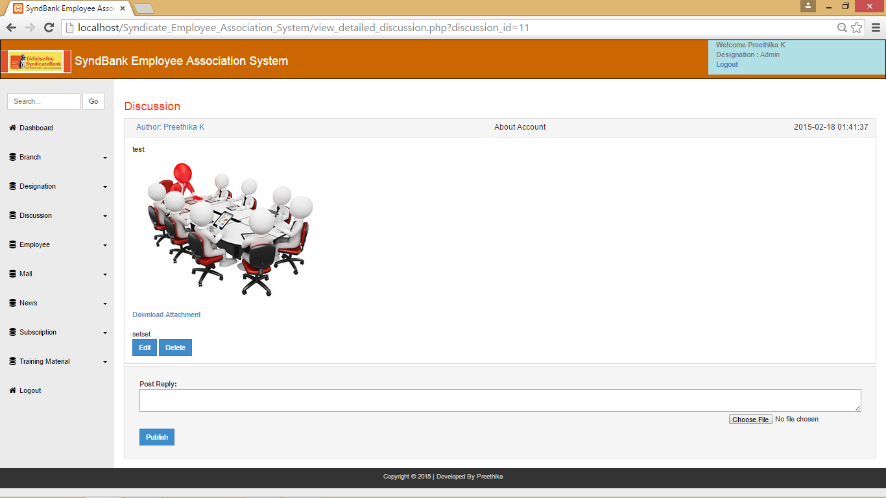
View Discussion :

Slide 35
TEST REPORTS
Login :
S.No. | Test Condition | Expected Result | Result
1 | Click on Sign in button without entering Username and Password | Failed Sign in.. | Successful
2 | Click on Sign in button without entering Username | Username should not be empty.. | Successful
3 | Click on Sign in button without entering Password | Kindly enter the password.. | Successful

Slide 36
Subscription :
S.No. | Test Condition | Expected Result | Result
1 | Click on Submit button without entering Card Number, CVV Number and Expiry Date | Enter the subscription details.. | Successful
2 | Click on Submit button without entering Card Number | Kindly enter the Card Number.. | Successful
3 | Click on Submit button without entering CVV Number | Kindly enter the CVV Number.. | Successful
4 | Click on Submit button without entering Expiry Date | Expiry month and expiry year should not be empty.. | Successful

Slide 37

USER MANUALS

Slide 38
Conclusion
The project titled “Employee Association System” has been designed and developed in PHP. Many user friendly controls are added to make it very interactive application.
The project is tested successfully and report is generated. The project has satisfied all the requirements. The software has been developed in an attractive user interactive fashion.
The software has fulfilled all the objectives identified and provides an attractive user friendly interface.
The reports requested by the user have been generated and all documentation required for operation and maintenance of the module has been provided.

Slide 39
Limitations
It cannot be used as offline since it is online program.
The Subscription amount module has virtual payment gateway and its not working like real-time payment gateway.
Since it is made for only employee of Syndicate Bank, it cannot be used by the employees of other banks
Program won’t work when server is down.

Slide 40
Scope for enhancements
In future we can add Web conference system feature.
In future a mobile application will be made to provide user friendly environment for employees
We can use cloud hosting for up gradation

Slide 41
bibliography
An integrated approach to Software Engineering, PankajJalote, 2ndedition, Narosa Publishing House 2004
Software Testing Tools, Dr.K.V.K.K Prasad, Dreamtech press
Sams Teach Yourself PHP, MySQL and Apache All in One (5th Edition), Julie Meloni
Learning PHP, MySQL, JavaScript, and CSS: A Step-by-Step Guide to Creating Dynamic Websites, Robin Nixon

